Slide 1
Building applications with GNU make
Mihai Todor
05.10.2015
Dublin C/C++ User Group

Slide 2

What is GNU make?
www.gnu.org/software/make/

Slide 3
GNU make
make – GNU make utility to maintain groups of programs
Determines automatically which pieces of large programs need to be recompiled and issues the commands to recompile them
Can be used with any programming language

Slide 4
GNU make
Interprets a file called Makefile to determine the relationships among source files and compilation commands
Updates a target if its dependencies have been modified after the target has been modified or if the target does not exist
Supports parallel compilation

Slide 5
Makefile example
hello_world: hello_world.o
gcc hello_world.o -o hello_world
hello_world.o: hello_world.c
gcc hello_world.c -c -o hello_world.o
run:
./hello_world
clean:
rm -rf hello_world.o hello_world

Slide 6
Longwinded version of…
gcc hello_world.c -o hello_world
./hello_world

Slide 7
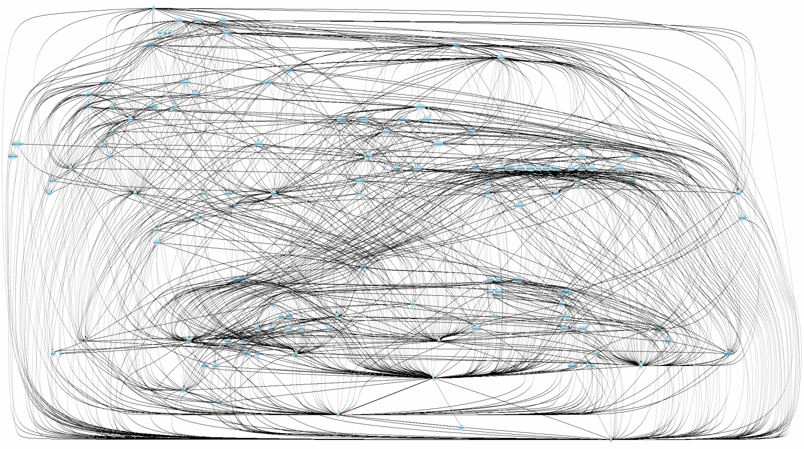
But things can get hairy

Slide 8
Makefiles
Describe the compilation graph
Written using the “Makefile language”
Similar to Declarative Programming
Make use of existing command line tools

Slide 9
Makefile rules
target: dependency1 dependency2 ...
recipe1
recipe2
...

Slide 10
Each recipe needs to be preceded by a TAB character
There can be multiple targets in a rule
Targets can represent generated files or not
The first target in the Makefile is implicitly the default one (can be changed)

Slide 11
Standard targets
all – compile everything (default target)
install – make all + copy binaries to install directories
uninstall – delete installed binaries
clean – remove files generated by make all
dist – create an archive of the compiled binary files, that can be installed on other machines
…

Slide 12
Special targets
Phony targets:
.PHONY : all install uninstall clean dist …
Default target:
.DEFAULT_GOAL: all
Serialize execution of dependencies:
.NOTPARALLEL: ...

Slide 13
Variables
Recursively expanded – expanded when the variable is substituted
REC_EXP = foo
Simply expanded variables – expanded when the variable is defined
SIMPLE_EXP := bar
Conditional assignment
FOO ?= foo bar

Slide 14
Automatic variables
$@ - The file name of the target of a rule
$< - The name of the first dependency
$^ - The names of all dependencies
$? – The names of the dependencies that are newer than the target

Slide 15
Environment variables
Make inherits all variables from the shell

Slide 16
Functions
Syntax: $(function arguments)
Example: $(subst from, to, text)
Replaces each occurrence of from with to in text
Many others:
www.gnu.org/software/make/manual/html_node/Functions.html

Slide 17
Pattern rules
A pattern rule contains one single % character in the target
A % in the dependencies of a pattern rule will contain the same string that is matched by the % in the target
Example:
%.o: %.c
recipe

Slide 18
make -j X (or --jobs X)
Runs recipes in parallel
recipes are assumed to be independent of each other
Uses as many jobs as possible if X is omitted
In practice, try nCores + 1 -> 1.5 * nCores
Compiling amalgamated code can’t be sped up this way

Slide 19
Libraries: static vs dynamic

Slide 20
More advanced build tools?
GNU Autotools
Cmake
Buck (Facebook)
Bazel (Google)
MSBuild (Microsoft)
Apache Maven
…

Slide 21
What build automation tools do you use?

Slide 22

See my activity on StackOverflow:
stackoverflow.com/users/1174378/mihai-todor
Follow me on:
Twitter: @MihaiTodor
Linkedin: www.linkedin.com/mtodor
Github: github.com/mihaitodor

